Slide 1
SOCIAL CONNECT & RESPONSIBILITIES

Slide 2
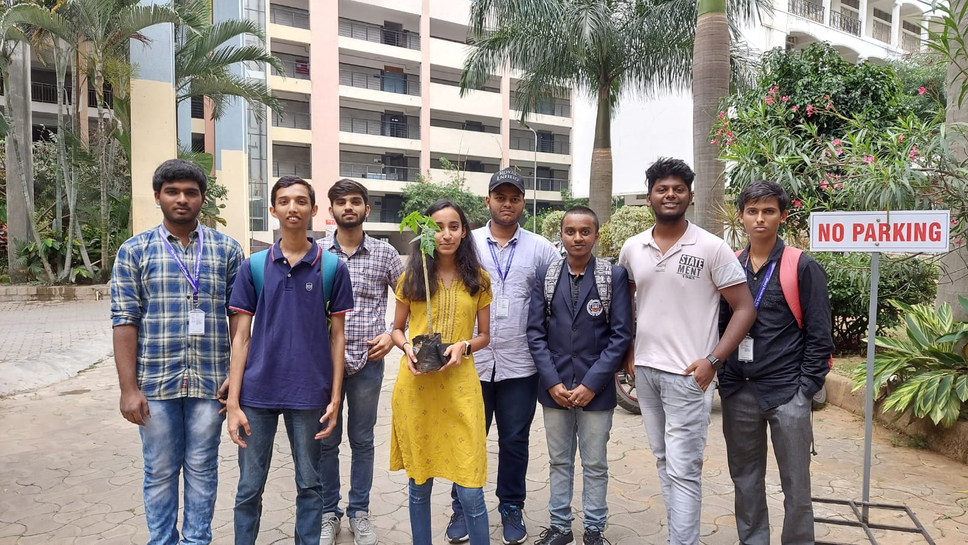
PLANTATION AND ADOPTION OF A TREES

Slide 3
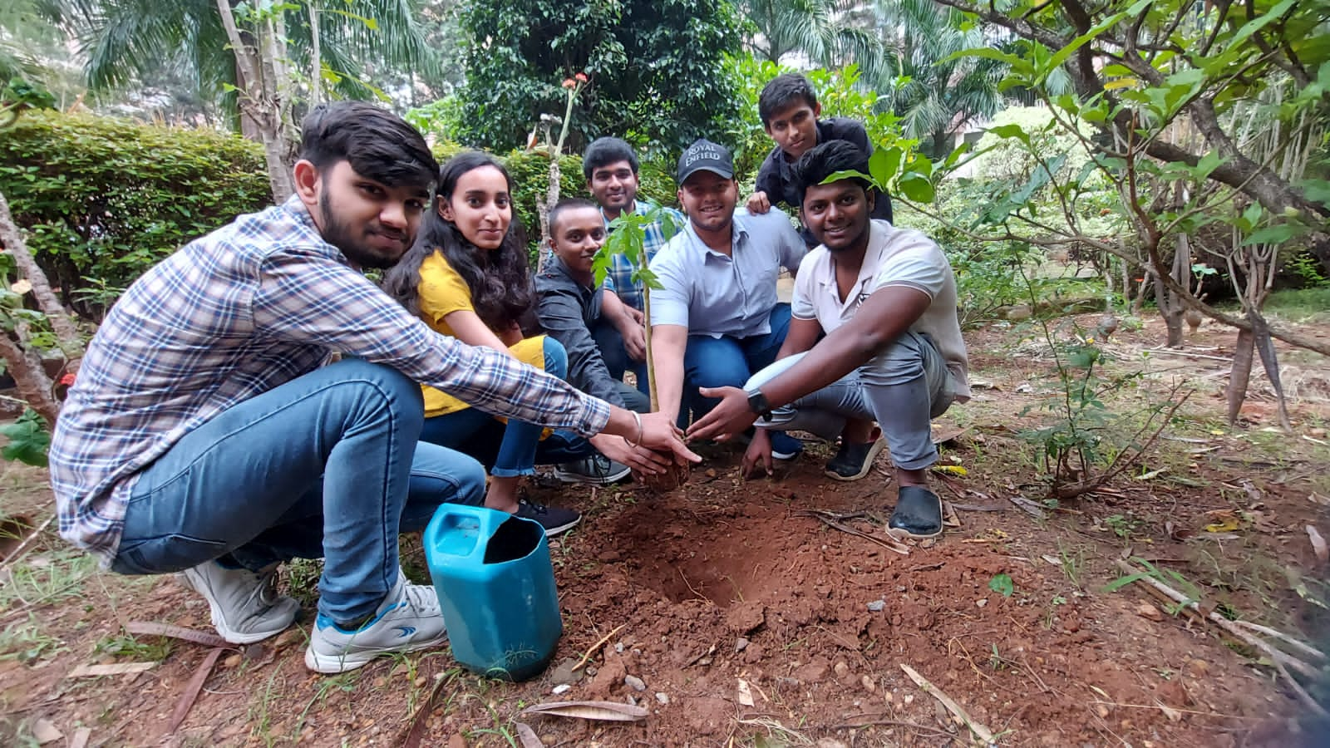
Plantation :
Plantation : An area of land where trees are grown to produce wood.

Slide 4
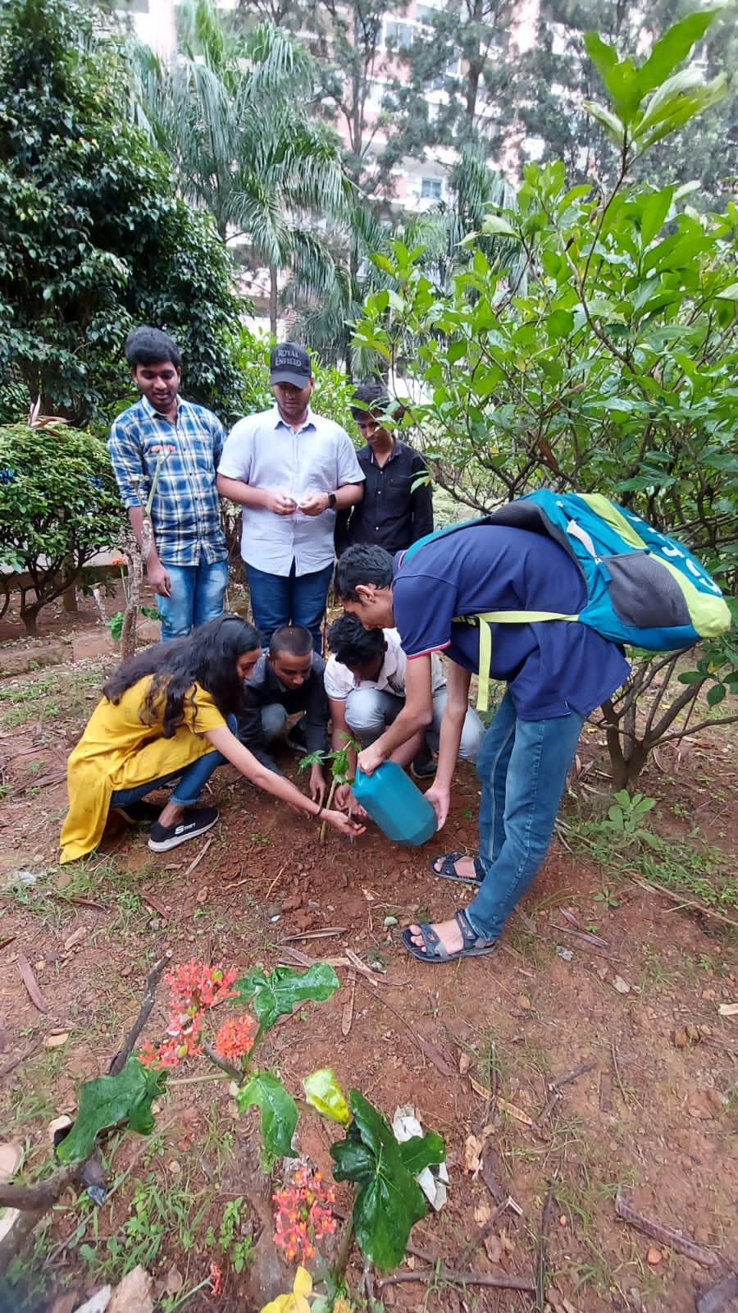
Adoption of trees :
Adopting of trees near by us and taking on regularly by supplying Water,Necessaryy minerals in the form of compost etc.
we need to keep our environment Green .

Slide 5
Why do we need plant and adopt trees?
we can have fresh air , fresh air keeps our mind fresh and more active. We need to conserve our green environment to the future for upcoming generations.

Slide 6
Health benefits
Many Parts of plants and trees are having medicinal qualities
Like:roots, leaves , fruits , seeds etc.
Papaya:
Fruit: contain high levels of antioxidants vitamin A, vitamin C, and vitamin E. Diets high in antioxidants may reduce the risk of heart disease.
Leaves: Juice of papaya leaves are recommended by doctors as it increases the number of platelets and helps to increase immunity.
Seeds : Are used in various Farmacitical industries in preparation of various medicines

Slide 7
Tax exemption benefit under 80G
WWF India initiated the ‘Adopt a Tree’ campaign in 2005 to encourage individuals and Organizations to plant and care for native species.
They will Issues a donation receipt upon completion of a transaction. An 80G certificate will be issued.
80G:Section 80G of the Income Tax Act primarily deals with donations made towards charity, with an aim to provide tax incentives to individuals indulging in philanthropic activities. This section offers tax deductions on donations made to certain funds or charities.

Slide 8
Procedure for adopting trees in India
1. https://join.wwfindia.org/adopt-a-tree/
2. STEP 1- Visit select FNP stores in Delhi NCR.
3. STEP 2- Choose your Tree Sapling absolutely free of cost.
The available choices are-Neem, Amaltas, Bhel, Kaner, Ashoka, Jamun, Imli etc.
4. STEP 3- Fill & Sign the pledge card at the store and hand it to the store manager
5. STEP 4- Take the Sapling with you and plant it.

Slide 9
Thank you

